Slide 1
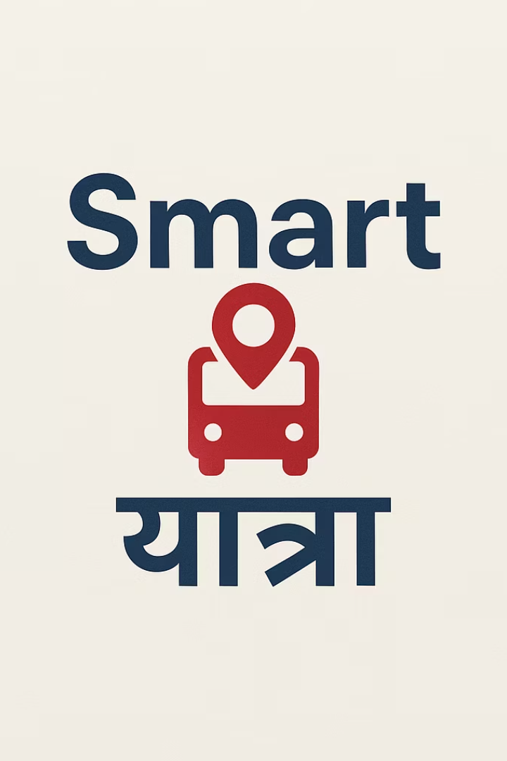



Smart Bus Tracking System
Enhancing Public Transportation Through Technology

Slide 2
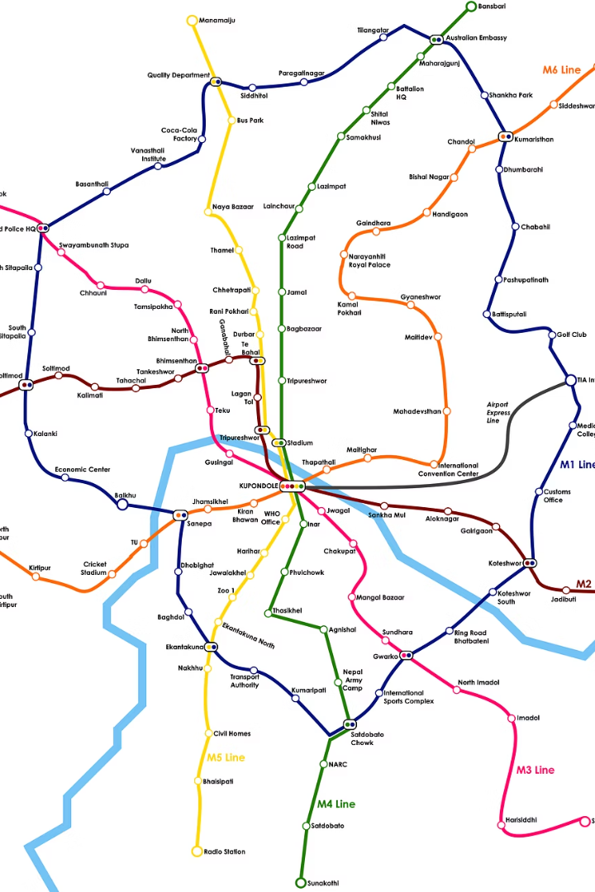







Overview
Purpose
Key Features
Modernize Nepal's public transport for daily commuters.
Real-time GPS tracking, ETA, driver behaviour monitoring, passenger alerts, predefined route.
Current Challenges
Future Opportunities
Unpredictable traffic, congestion, safety, lack of data.
Integrate with urban services, scale nationwide for broader impact.

Slide 3



Key Features
Estimated Time of Arrival (ETA)
Driver Behavior Monitoring
Real-time bus location via GPS, updating every 10 seconds.
Tracks speed, harsh braking, rapid acceleration, idling events.
Predictive algorithm for 95% accurate arrival times at 5,000+ stops.
Alerts for geofence violations and unauthorized stops.
Accessible via mobile app and public display screens.
Data supports performance reviews and safety training, aiming for 15% reduction in traffic violations.

Slide 4
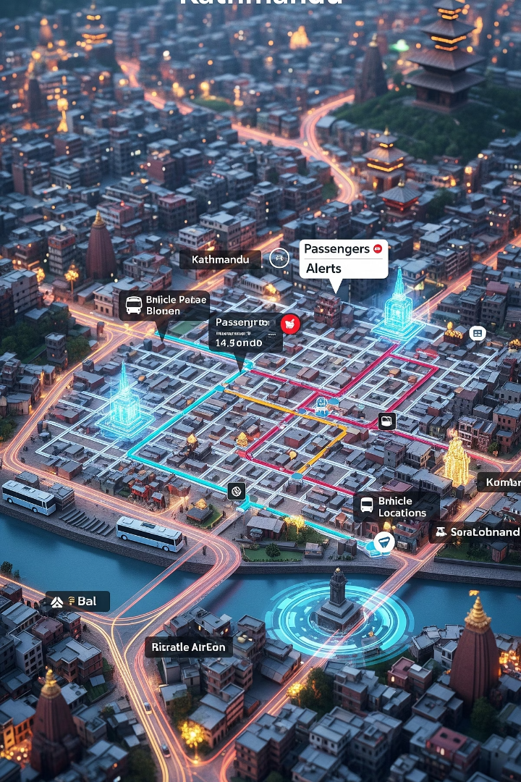



Key Features
Route Optimization
AI-driven dynamic routing adjusts for traffic congestion for 20% faster travel times.
Identifies efficient routes and schedules based on data.
Supports dynamic adjustments for emergencies.
Passenger Alerts & Notifications
Push notifications for bus arrivals, delays, and disruptions.
Alerts reduce wait times by 25%.
Provides alternate route suggestions during delays.
Emergency SOS Button
Direct connection to dispatch center and emergency services.
Instant GPS location sharing for rapid response, reducing time by 50%.

Slide 5

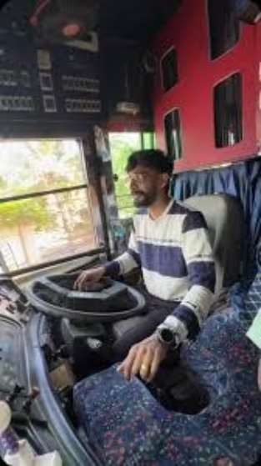

User Side Benefits
Driver Side Benefits
Reduces idle time and helps in assigning the right number of buses per route.
Reduces stress in unfamiliar or high-traffic areas.
Clear schedules, stops, and app-based info reduce confrontations over delays or wrong routes.
ETA info and cleaner routes lead to better user experience, encouraging regular use.
Predefined routes and schedule help drivers avoid confusion and disputes.
Real-time tracking reduces delays and route confusion.

Slide 6
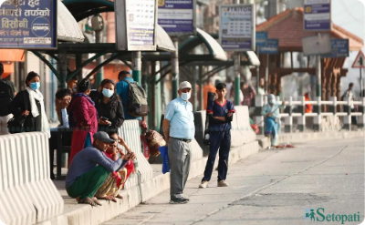
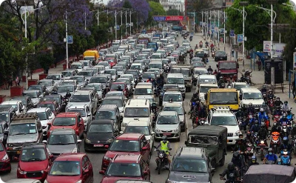
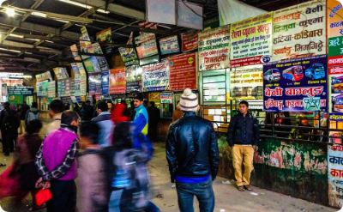
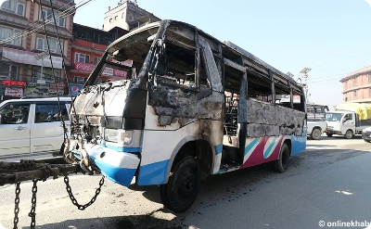


Current Challenges
Unpredictable Schedules
Traffic Congestion
No Real-time Information
Safety Concerns
Kathmandu ranks among most populated cities, with unoptimized public transport contributing significantly to bottlenecks.
25% of road accidents involve public transport, often linked to reckless driving.
Over 70% of commuters report inconsistent timings, leading to average 30+ minute wait times.
There is no centralized system for bus locations, resulting in 85% of passengers lacking access to real-time data.

Slide 7






Impacts
Enhanced Safety & Security
Improved Passenger Experience
15% reduction in public transport accidents.
2
40% increase in rider satisfaction.
Through driver monitoring and SOS features.
1
Due to predictability and real-time info.
3
Operational Efficiency
10% fuel cost savings for operators.
Environmental Impact
Optimized fleet management.
5
Reduced idling and optimized routes.
Data-Driven Urban Planning
4
Lower emissions, supporting climate goals.
Actionable insights for new routes.
Improving city flow by 20%.

Slide 8

Implementation & Scalability
1
Pilot Phase (Kathmandu Valley)
Launch on major routes within Kathmandu Vallley, covering 400+ buses and 100,000+ daily passengers within 6 months.
2
Technology Stack
GPS, IoT sensors, cloud-based platform (AWS/Azure), mobile
applications.
3
Partnerships
Collaborate with Nepal Department of Transport Management, local bus operators.
4
Phased Rollout
Expand to Pokhara and Biratnagar within 18-24 months, scaling to 2,000+ buses.

Slide 9
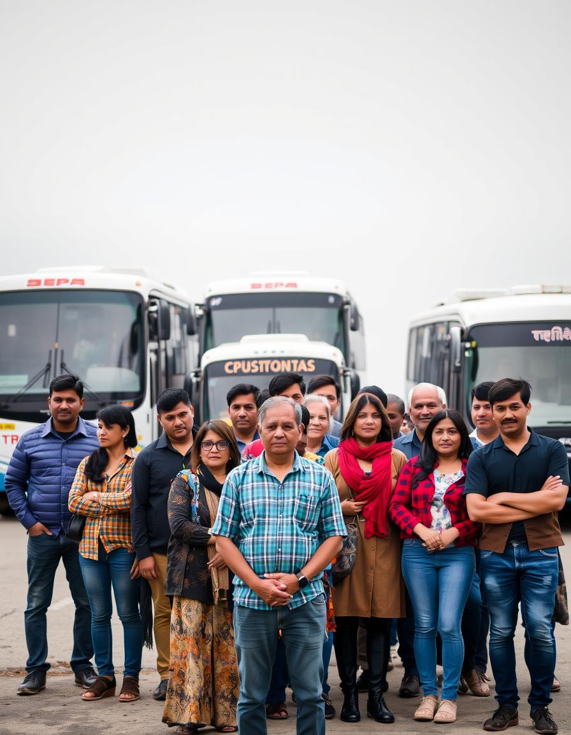
Conclusion & Call to Action
50K
500+
100k+
Initial Funding Needed
Buses Scalable To
Daily Commuters Impacted
For pilot program (200 buses).
In other major urban centers.
By a reliable system.
A smart bus tracking system is critical for modernizing Nepal's public transportation. Our vision is to create a reliable, efficient, and safe network for millions of Nepali citizens. We seek strategic partnerships and initial funding to begin the technical design phase. Your support is essential for a more connected, sustainable Nepal.

